Slide 1




Introduction to HTML and CSS
Discover the fundamental building blocks of modern web development. HTML and CSS form the foundation for creating visually appealing and interactive websites that provide an excellent user experience.
by Daniyal Haider

Slide 2

What is HTML?
Foundation of the Web
Building Blocks
HTML, or Hypertext Markup Language, is the foundational code that structures the content and layout of web pages.
HTML uses a series of elements and tags to define the meaning and structure of web page components.
Semantic Markup
HTML provides semantic meaning to content, enabling browsers to understand and properly render the information.

Slide 3

HTML Elements and Structure
HTML documents are composed of elements that define the structure and content of the webpage.
Elements are denoted by tags enclosed in angle brackets, like <p> for paragraphs or <h1> for headings.
Elements can have attributes that provide additional information, such as the href attribute on <a> tags to specify a link's destination.

Slide 4

Attributes in HTML
HTML attributes provide additional information about an element. They appear inside the opening tag and consist of a name-value pair. Attributes are used to modify the default behavior or appearance of an element, such as setting the size, color, or linking to external resources.
Common HTML attributes include id, class, src, href, alt, and many others. Attributes give developers greater control over the structure and styling of web pages.

Slide 5

What is CSS?
CSS, or Cascading Style Sheets, is the language used to control the visual presentation of web pages. It allows developers to separate content from design, making it easier to maintain and update websites.

Slide 6

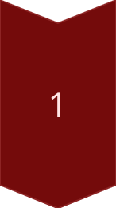
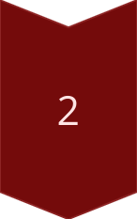
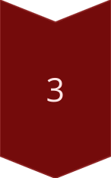
CSS Syntax and Selectors
CSS Syntax
CSS follows a simple syntax: selector { property: value; }. Selectors target HTML elements, properties define how they should look, and values set the specific styling.
Type Selectors
These target specific HTML elements, like h1, p, or div. They apply styles directly to those tags.
Class and ID Selectors
These target elements with specific class or ID attributes. They allow for more precise targeting and reusable styles.

Slide 7

Applying Styles with CSS
CSS, or Cascading Style Sheets, is the language used to apply styles and formatting to HTML elements on a web page. With CSS, you can control the layout, colors, fonts, and other visual aspects of your website or web application.
Styles are applied using CSS selectors that target specific HTML elements. Once selected, you can set properties like font-size, color, background-color, and more to achieve the desired visual design.

Slide 8




CSS Box Model
Content
1
The innermost layer of the box model, containing the actual content.
2
Padding
The space between the content and the border.
3
Border
The line surrounding the padding and content.
Margin
4
The space between the border and the surrounding elements.
The CSS box model is a fundamental concept that describes how elements are sized and positioned on a web page. Understanding the box model, with its four key components - content, padding, border, and margin - is crucial for effectively controlling the layout and spacing of HTML elements using CSS.

Slide 9
Responsive Web Design with CSS
1K
80%
Devices
Mobile Usage
Websites accessed from a wide range of devices, from desktops to smartphones.
Majority of web traffic now comes from mobile devices.
Responsive web design is a crucial consideration in modern web development. As the number of devices and screen sizes continues to grow, it's essential to create websites that can adapt and provide an optimal user experience across all platforms.
CSS plays a vital role in responsive design, offering tools and techniques to ensure a site's layout, content, and functionality are properly scaled and rearranged based on the user's device and viewport. This allows for a seamless, high-quality experience no matter how the user is accessing the website.

